Slide 1

Simplification of Grammar
Removal of Ambiguity
Removal of Left Recursion
Left Factorization of Grammar
Removal of Unit Productions
Removal of Null/ε-Production
Removal of Useless production/symbol

Slide 2
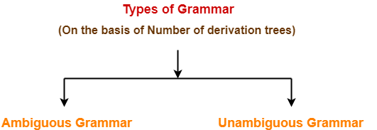
Ambiguity of Grammar

Slide 3
Ambiguous Grammar-
A grammar is said to ambiguous if for any string generated by it, it produces more than one-
Parse tree
Or derivation tree
Or syntax tree
Or leftmost derivation
Or rightmost derivation
Example-
Consider the following grammar-
E → E + E / E x E / id
Ambiguous Grammar
This grammar is an example of ambiguous grammar.
Any of the following reasons can be stated to prove the grammar ambiguous-

Slide 4
G=({id,+,*},{E},E,P) where P is
E → E + E
E→ E x E
E→id/0|1|2|3|…|9
E→E+E→id+E→id+id
E→E*E→id*E→id*id
E→E+E→id+E→id+E*E→id+id*E→id+id*id//2+3*4--------20----------------14
L(G)={id,id+id,id*id,id+id*id,id+id+id,id*id*id,…….}
Consider string w=id+id*id, try to derive 2 parse tree

Slide 5
Id+id*id
E→E+E→id+E→id+E*E→id+id*E→id+id*id///20
E→E*E→E+E*E→id+E*E→id+id*E→id+id*id/////14

Slide 6
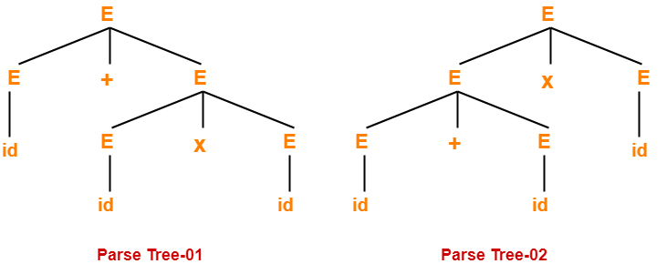
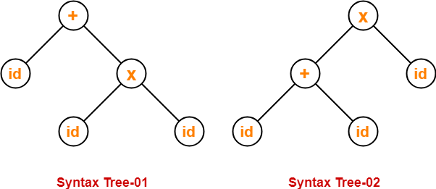
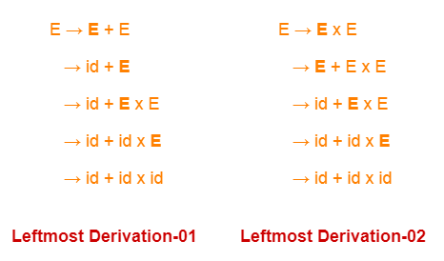
Reasons:-
Reason-01:
Let us consider a string w generated by the grammar-
w = id + id x id
Now, let us draw the parse trees for this string w.
Since two parse trees exist for string w, therefore the grammar is ambiguous.
Reason-02:
Let us consider a string w generated by the grammar-
w = id + id x id
Now, let us draw the syntax trees for this string w.
Since two syntax trees exist for string w, therefore the grammar is ambiguous.
Reason-02:
Let us consider a string w generated by the grammar-
w = id + id x id
Now, let us write the leftmost derivations for this string w.
Since two leftmost derivations exist for string w, therefore the grammar is ambiguous.

Slide 7
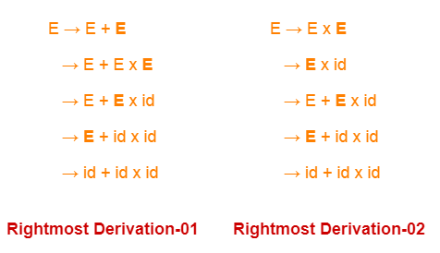
Reason-04:
Let us consider a string w generated by the grammar-
w = id + id x id
Now, let us write the rightmost derivations for this string w.
Since two rightmost derivations exist for string w, therefore the grammar is ambiguous.
E→E+T \ T
T→T*F \ F
F→id
E→E+T→E+T+T
→E+T→T+T

Slide 8
Problem-01:
Check whether the given grammar is ambiguous or not-
S → SS
S → a
S → b
L(G)={ab, ba,aa,bb,bab,abba,aba,…..}

Slide 9
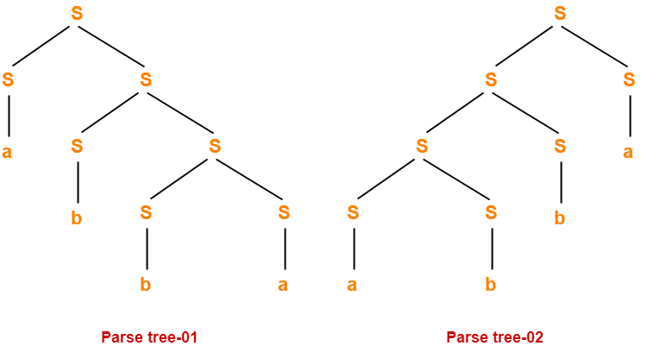
Solution
Let us consider a string w generated by the given grammar-
w = abba
Now, let us draw parse trees for this string w.
Since two different parse trees exist for string w, therefore the given grammar is ambiguous.

Slide 10
Problem-02:
Check whether the given grammar is ambiguous or not-
S → A / B
A → aAb / ab
B → abB / ∈
Option 1
S→A----S→ab
Option 2
S→B-----S→abB-----s→ab

Slide 11
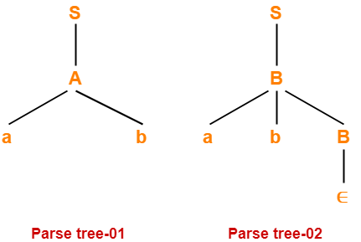
Solution-
Let us consider a string w generated by the given grammar-
w = ab
Now, let us draw parse trees for this string w.
Since two different parse trees exist for string w, therefore the given grammar is ambiguous.

Slide 12
Why need to remove ambiguity?
Let us now consider the following grammar:
From the above grammar String 3*2+5 can be derived in 2 ways:
Hence need to remove ambiguity
Set of alphabets ∑ = {0,…,9, +, *, (, )}
E -> I
E -> E + E
E -> E * E
E -> (E)
I ->| 0 | 1 | … | 9
I) First leftmost derivation II) Second leftmost derivation III) derivation
E=>E*E E=>E+E E→E*E
=>I*E =>E*E+E →E*E+E
=>3*E+E =>I*E+E →E*E+5
=>3*I+E =>3*E+E →E*2+5
=>3*2+E =>3*I+E →E*7
=>3*2+I =>3*2+I →3*7
=>3*2+5 =>11 =>3*2+5 => 11 →21

Slide 13
Removal of Ambiguity
A grammar is said to unambiguous if for every string generated by it, it produces exactly one-
Parse tree
Or derivation tree
Or syntax tree
Or leftmost derivation
Or rightmost derivation

Slide 14
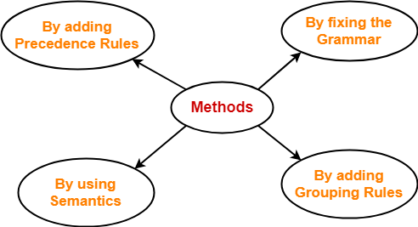
Methods To Remove Ambiguity-
The ambiguity from the grammar may be removed using the following methods-
By fixing the grammar
By adding grouping rules
By using semantics and choosing the parse that makes the most sense
By adding the precedence rules or other context sensitive parsing rules

Slide 15
Example 1:-
Convert the following ambiguous grammar into unambiguous grammar-
E → E + E / E . E / E* / a / b--------------E→E+E|E-E|E*E|E/E|id---id>/>*>+,-
where * is kleen closure and . is concatenation.
To convert the given grammar into its corresponding unambiguous grammar, we implement the precedence and associativity constraints.
We have-
Given grammar consists of the following operators- + , . , *
Given grammar consists of the following operands- a , b
The priority order is- (a , b) > * > . > +
where-
. operator is left associative//////2+3+4---5+4===9///power operator 2power3power2-----3power2=9-----====2power9=512//right associative operator
+ operator is left associative

Slide 16
E→E+E | E-E//E➔E+E+E→E-E+E+E
Recursion
Left and right recursion
Here u have to remove only one recursion
If the operator is left associative, remove right recursion
If the operator is right associative, remove left recursion
E→E+E | E-E---------id-id
E→E+T | T
E→E↑E
E→G ↑E | G

Slide 17
Leveling the given grammar
The priority order is- (a , b)> ↑ > * > . > +
E → E + E / E . E / E* / E↑E / a / b-
E➔E+E--------E→E+T | T//////E→E+E+E+E……..///E→E+T
E→E.E---------T→T.F | F
E→E*------F→G*
E→ E↑E ------G→R ↑E | R
E→a |b-----R-->a |b

Slide 18
Consider the given grammar
E→E+E | E.E |E* a|b
Using the precedence and associativity rules, we write the corresponding unambiguous grammar as- a.b, a*
E→T---T→F---F→
E → E + T | T---------E→E+E
T → T . F |F
F → F* / G
G → a / b
Unambiguous Grammar
OR
E → E + T / T
T → T . F / F
F → F* / a / b
Unambiguous Grammar

Slide 19
Example 2:-
Convert the following ambiguous grammar into unambiguous grammar-
bexp → bexp or bexp / bexp and bexp / not bexp / t / f
where bexp represents Boolean expression, t represents True and f represents False.
To convert the given grammar into its corresponding unambiguous grammar, we implement the precedence and associativity constraints.
We have-
Given grammar consists of the following operators-
or , and , not
Given grammar consists of the following operands-
T , F
The priority order is-
(T , F) > not > and > or
where-
and operator is left associative
or operator is left associative

Slide 20
Using the precedence and associativity rules, we write the corresponding unambiguous grammar as-
bexp → bexp or M / M
M → M and N / N
N → not N / G
G → T / F
Unambiguous Grammar
OR
bexp → bexp or M / M
M → M and N / N
N → not N / T / F
Unambiguous Grammar

Slide 21
Left Recursion-
A production of grammar is said to have left recursion if the leftmost variable of its RHS is same as variable of its LHS.
A grammar containing a production having left recursion is called as Left Recursive Grammar.
Example-
S → Sa / ∈
(Left Recursive Grammar)
Left recursion is considered to be a problematic situation for Top down parsers.
Therefore, left recursion has to be eliminated from the grammar.

Slide 22
Elimination of Left Recursion
Left recursion is eliminated by converting the grammar into a right recursive grammar.
If we have the left-recursive pair of productions-
A → Aα / β
(Left Recursive Grammar)
where β does not begin with an A.
Then, we can eliminate left recursion by replacing the pair of productions with-
A → βA’
A’ → αA’ / ∈
(Right Recursive Grammar)
This right recursive grammar functions same as left recursive grammar.

Slide 23
Examples:
Consider the following grammar and eliminate left recursion-
A → Aα1 |Aα2 / β1 | β2 |β3
A→βA’
A’→α1 A’ |α2 A’ |∈
A → ABd / Aa / a------A → Aα1 |Aα2 / β
B → Be / b------A → Aα/ β
The grammar after eliminating left recursion is-
A → aA’
A’ → BdA’ / aA’ / ∈
B → bB’
B’ → eB’ / ∈

Slide 24
Consider the following grammar and eliminate left recursion-
E → E + E / E x E / a----A → Aα1 |Aα2 / β
Solution-
Th grammar after eliminating left recursion is-
E → aE’
E’ → +EE’ / xEE’ / ∈
Consider the following grammar and eliminate left recursion-
E → E + T / T
T → T x F / F
F → id
The grammar after eliminating left recursion is-
E → TE’
E’ → +TE’ / ∈
T → FT’
T’ → xFT’ / ∈
F → id

Slide 25
Indirect Left Recursion
Consider the following grammar and eliminate left recursion-
X → XSb / Sa / b
S → Sb / Xa / a
Step-02:
Substituting the productions of X in S → Xa, we get the following grammar-
X → SaX’ / bX’
X’ → SbX’ / ∈
S → Sb / SaX’a / bX’a / a---A → Aα1 |Aα2 / β1\ β2
Step-03:
Now, eliminating left recursion from the productions of S, we get the following grammar-
X → SaX’ / bX’
X’ → SbX’ / ∈
S → bX’aS’ / aS’
S’ → bS’ / aX’aS’ / ∈
Step-01:
First let us eliminate left recursion from
X → XSb / Sa / b
Eliminating left recursion from here, we get-
X → SaX’ / bX’
X’ → SbX’ / ∈
Now, given grammar becomes-
X → SaX’ / bX’
X’ → SbX’ / ∈
S → Sb / Xa / a

Slide 26
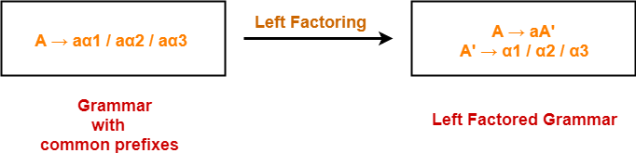
Left Factorization
Left factoring is a process by which the grammar with common prefixes is transformed to make it useful for Top down parsers.
How?-ab----A→aP | aS| P→b S→a
In left factoring,
We make one production for each common prefixes.
The common prefix may be a terminal or a non-terminal or a combination of both.
Rest of the derivation is added by new productions.
The grammar obtained after the process of left factoring is called as Left Factored Grammar.

Slide 27
Examples:-
Do left factoring in the following grammar-
S → iEtS / iEtSeS / a
E → b
The left factored grammar is-
S → iEtSS’ / a
S’ → eS / ∈
E → b

Slide 28
Do left factoring in the following grammar-
A → aAB / aBc / aAc
Solution-
Step-01:
A → aA’
A’ → AB / Bc / Ac
Again, this is a grammar with common prefixes.
Step-02:
A → aA’
A’ → AD / Bc
D → B / c
This is a left factored grammar.

Slide 29
Do left factoring in the following grammar-
S → a / ab / abc / abcd
Solution-
Step-01:
S → aS’
S’ → b / bc / bcd / ∈
Again, this is a grammar with common prefixes.
Step-02:
S → aS’
S’ → bA / ∈
A → c / cd / ∈
Again, this is a grammar with common prefixes.
Step-03:
S → aS’
S’ → bA / ∈
A → cB / ∈
B → d / ∈
This is a left factored grammar.

Slide 30
Removal of Useless Symbols
A symbol can be useless if it does not appear on the right-hand side of the production rule and does not take part in the derivation of any string.
That symbol is known as a useless symbol.
Similarly, a variable can be useless if it does not take part in the derivation of any string.
That variable is known as a useless variable.

Slide 31
Consider the grammar
T → aaB | abA | aaT
A → aA
B → ab | b
C → ad
In the above example, the variable 'C' will never occur in the derivation of any string, so the production C → ad is useless. So we will eliminate it, and the other productions are written in such a way that variable C can never reach from the starting variable 'T'.
Production A → aA is also useless because there is no way to terminate it. If it never terminates, then it can never produce a string. Hence this production can never take part in any derivation.
To remove this useless production A → aA, we will first find all the variables which will never lead to a terminal string such as variable 'A'. Then we will remove all the productions in which the variable 'B' occurs.

Slide 32
Removal of Null/Ɛ-production
The productions of type S → ε are called ε productions. These type of productions can only be removed from those grammars that do not generate ε.
Step 1: First find out all nullable non-terminal variable which derives ε.
Step 2: For each production A → a, construct all production A → x, where x is obtained from a by removing one or more non-terminal from step 1.
Step 3: Now combine the result of step 2 with the original production and remove ε productions.

Slide 33
Remove the production from the following CFG by preserving the meaning of it.
S → XYX---S→XYX| YX|XY |Y|XX
X → 0X | ε -----X→0X |0
Y → 1Y | ε ------Y→1Y |1
Now, while removing ε production, we are deleting the rule X → ε and Y → ε. To preserve the meaning of CFG we are actually placing ε at the right-hand side whenever X and Y have appeared.
Let us take-S → XYX
If the first X at right-hand side is ε. Then-S → YX
Similarly if the last X in R.H.S. = ε. Then-S → XY
If Y = ε then-S → XX
If Y and X are ε then,S → X
If both X are replaced by ε, S → Y
Now,
S → XY | YX | XX | X | Y
Now let us consider
X → 0X
If we place ε at right-hand side for X then,
X → 0
X → 0X | 0
Similarly Y → 1Y | 1
Collectively we can rewrite the CFG with removed ε production as
S → XY | YX | XX | X | Y
X → 0X | 0
Y → 1Y | 1

Slide 34
Removing Unit Productions
The unit productions are the productions in which one non-terminal gives another non-terminal. Use the following steps to remove unit production:
Step 1: To remove X → Y, add production X → a to the grammar rule whenever Y → a occurs in the grammar.
Step 2: Now delete X → Y from the grammar.
Step 3: Repeat step 1 and step 2 until all unit productions are removed.

Slide 35
Remove unit production from the given grammar
S → 0A | 1B | C -------- S → 0A | 1B | 01
A → 0S | 00
B → 1 | A -----------------B → 1 | 0S | 00
S → C is a unit production. But while removing S → C we have to consider what C gives. So, we can add a rule to S.
S → 0A | 1B | 01
Similarly, B → A is also a unit production so we can modify it as
B → 1 | 0S | 00
Thus finally we can write CFG without unit production as
S → 0A | 1B | 01
A → 0S | 00
B → 1 | 0S | 00
C → 01

